Slide 1
Data Analysis & Visualization
“THE SAN FRANCISCO BIKE SHARE”
FINDI VERDIAN’S PROJECT

Slide 2
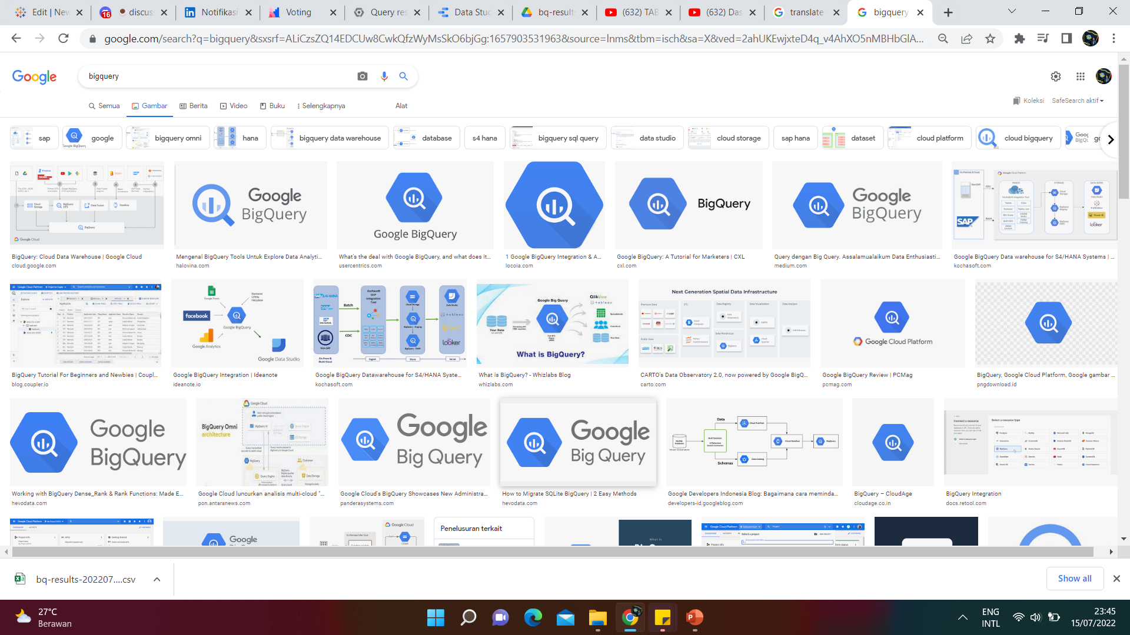
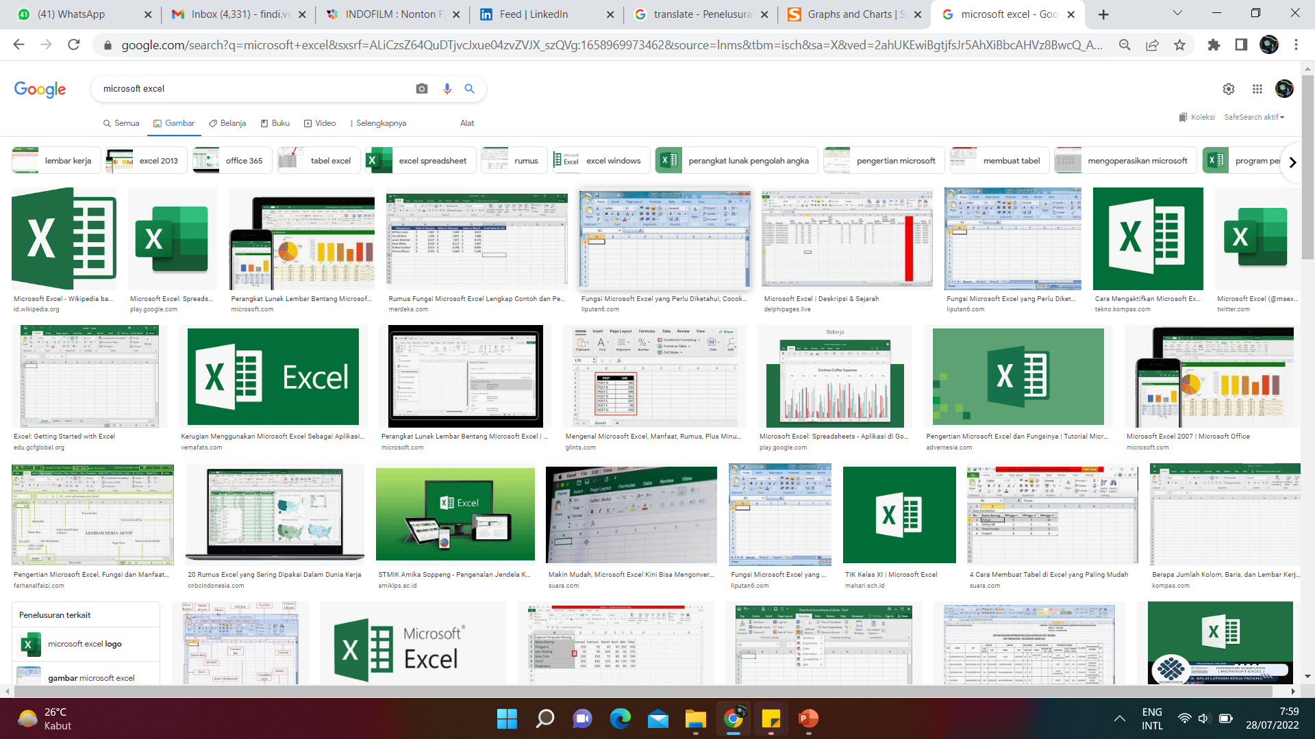
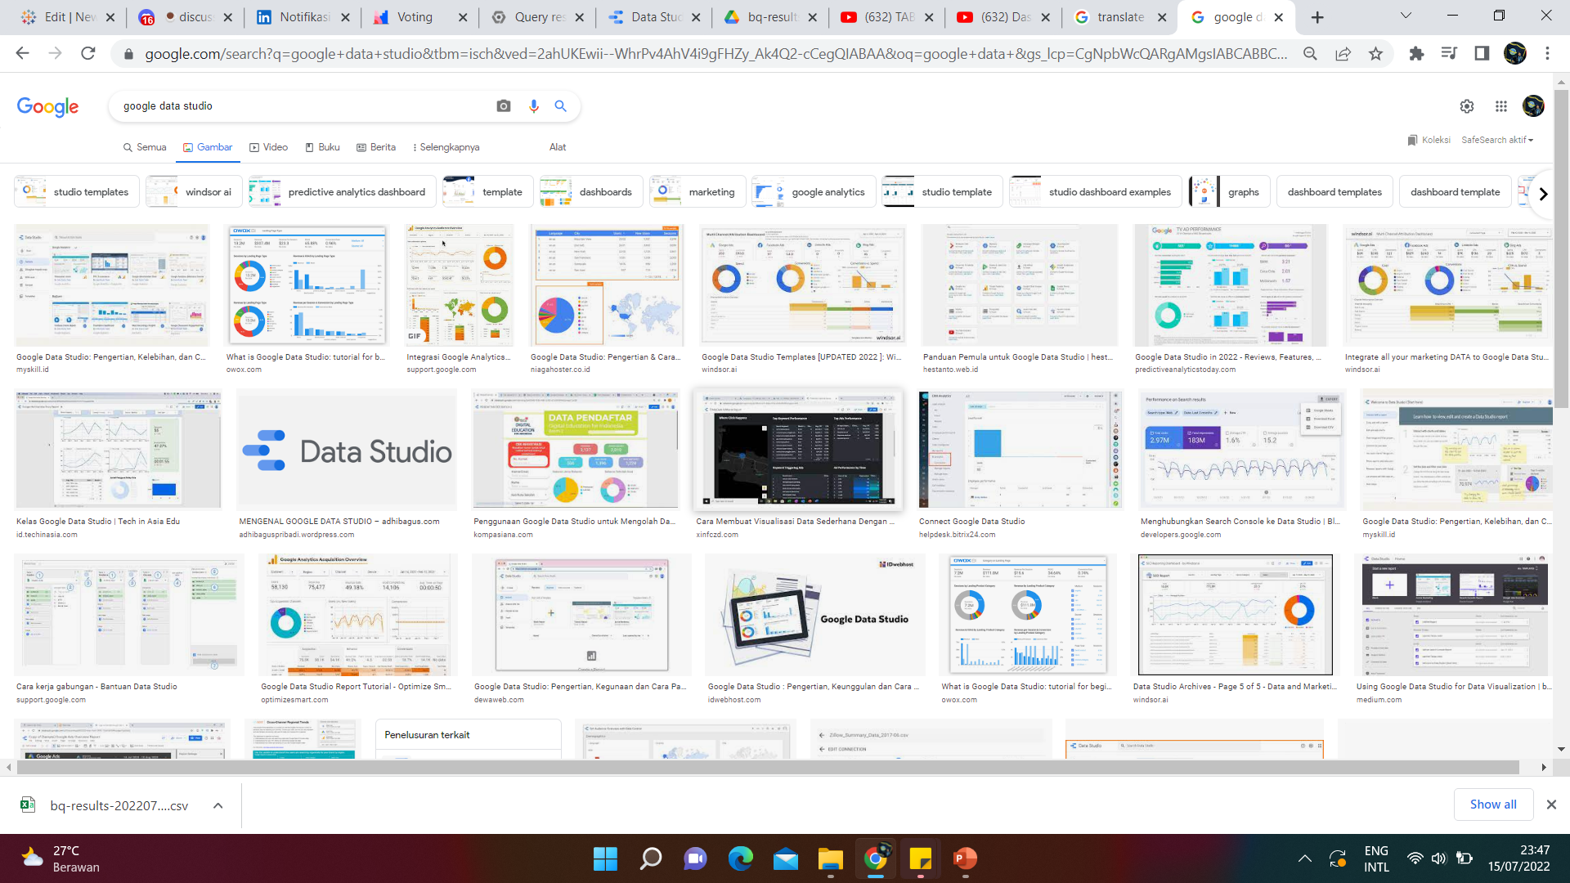
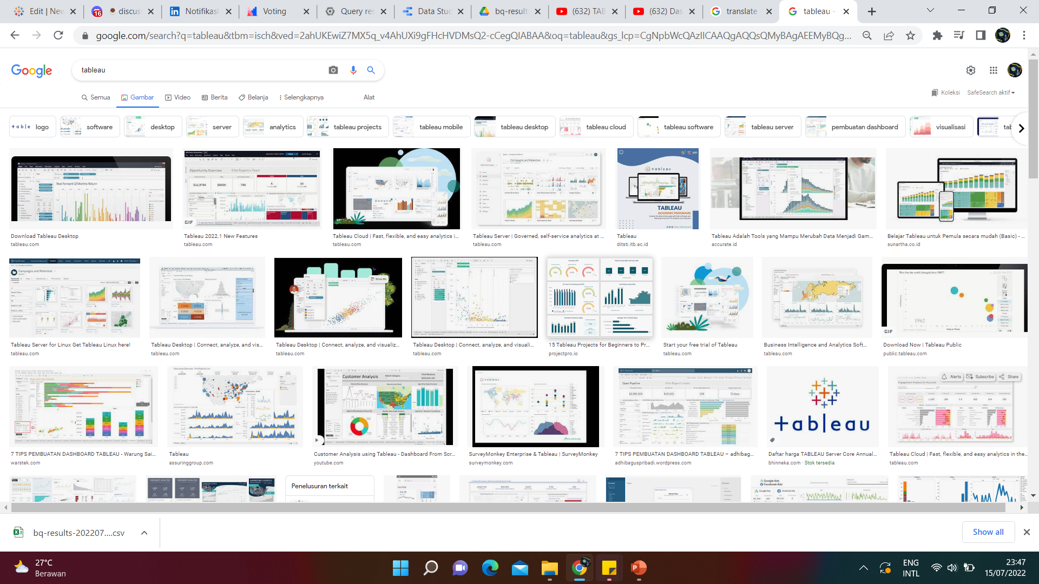
Data Cleaning and Analyzing
BigQuery
Microsoft EXCEL
TOOLS
Data Visualitation and Dashboard
Google Data Studio
Tableau
FINDI VERDIAN’S PROJECT

Slide 3
DEFINING THE PROBLEMS
How
was the weekly trend?
How
about the characteristic of the bike users?
How
was the distribution of the bikes availability?
FINDI VERDIAN’S PROJECT

Slide 4

EXPLORING DATA
FINDI VERDIAN’S PROJECT

Slide 5
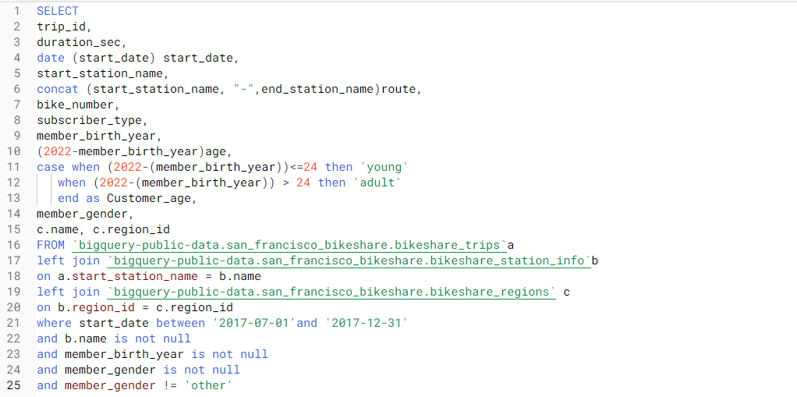
SQL WORKSPACE

Slide 6
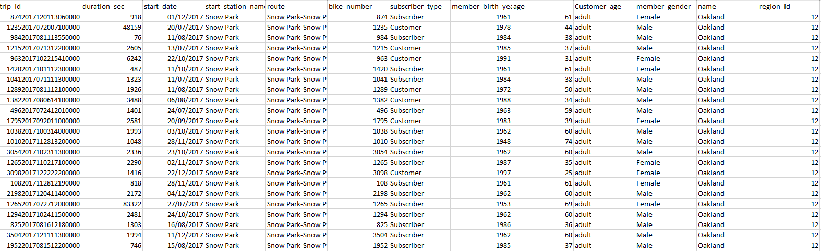
QUERY RESULT

Slide 7
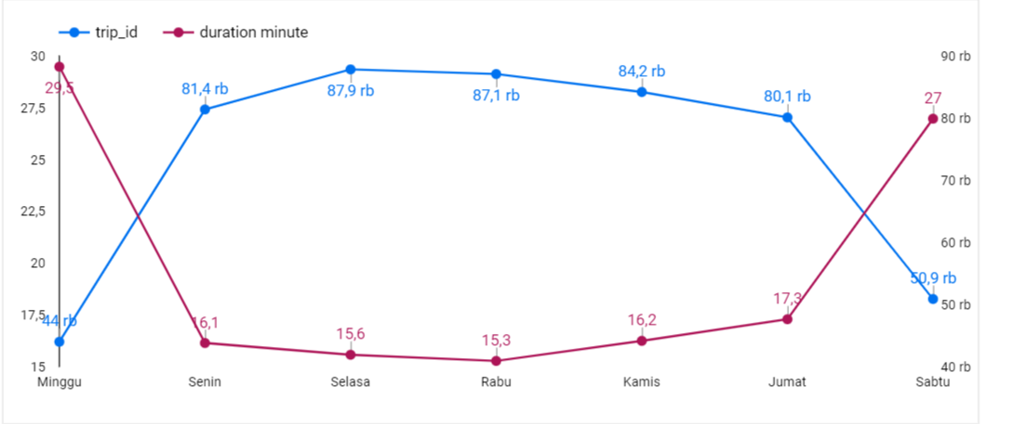
TREND IN A WEEK
In this table we can see that the customers trends of renting the bike on Monday and Saturday are longer than usual

Slide 8

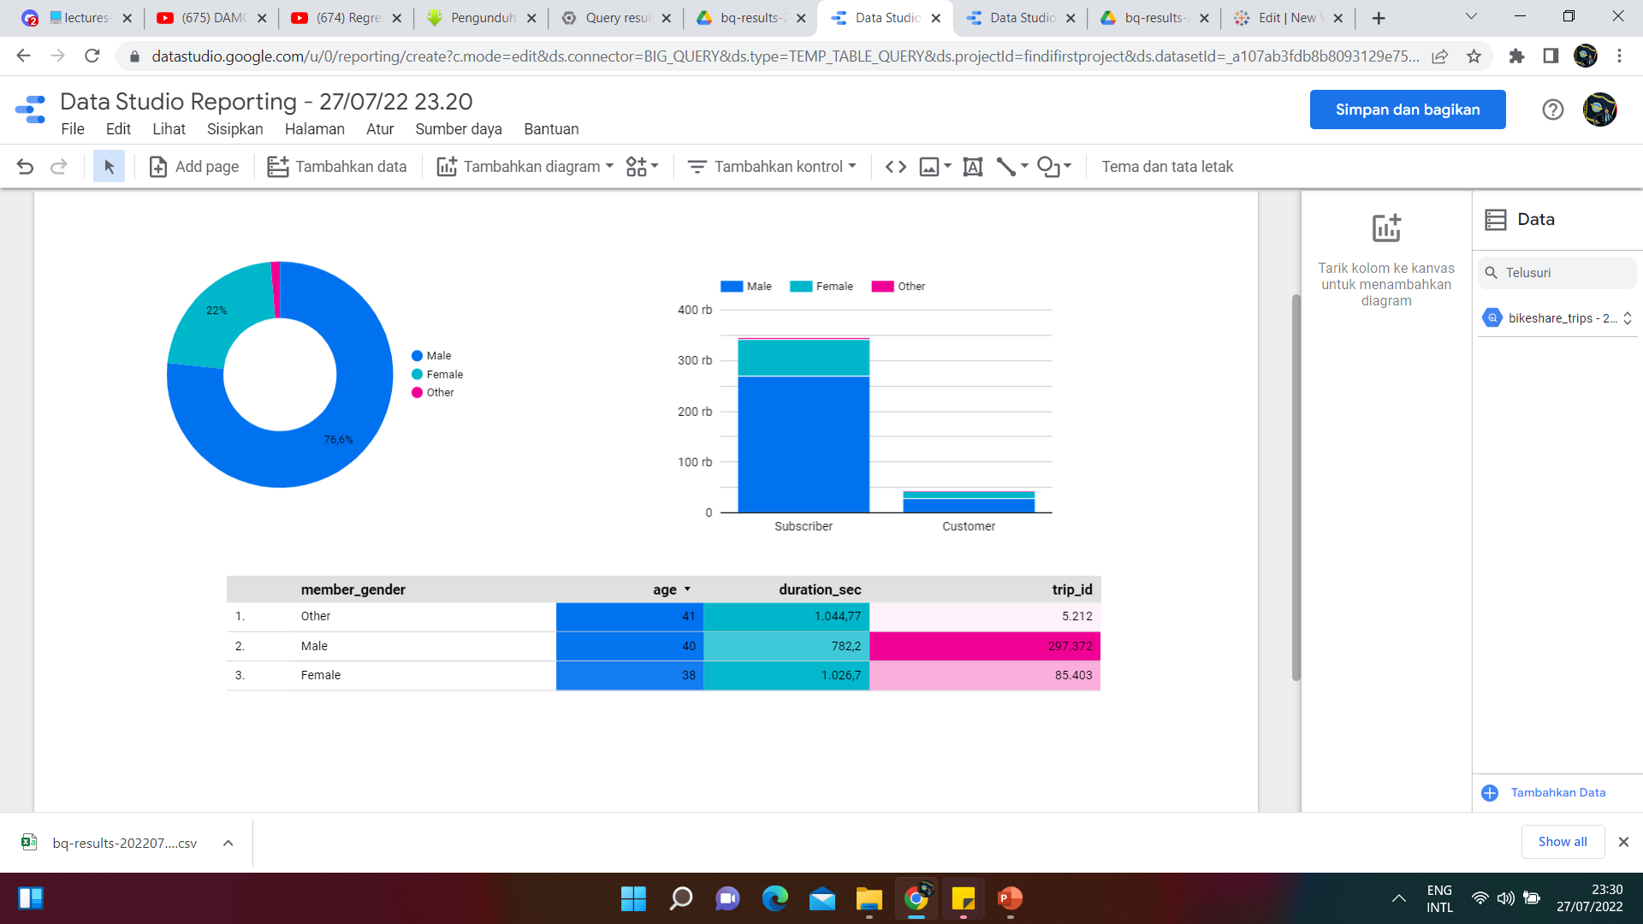
CUSTOMER’S TREND
Males mostly dominated the rental amount, therefore females mostly dominate the longest rental duration

Slide 9
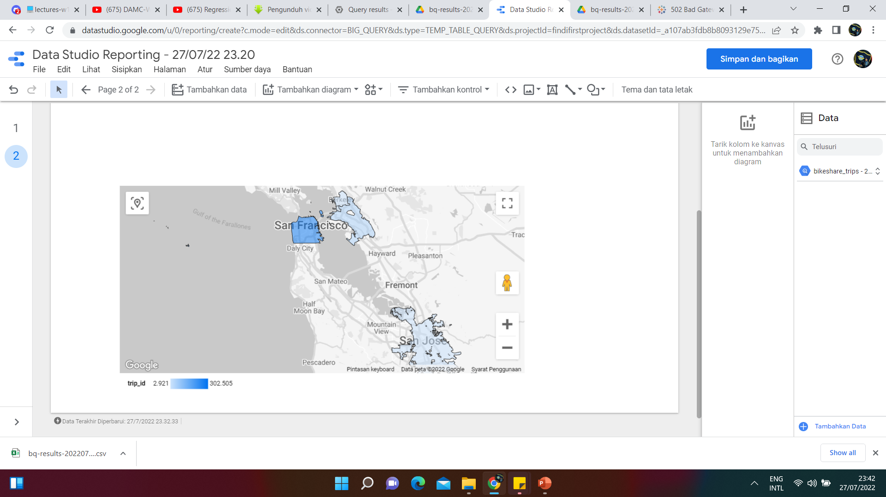
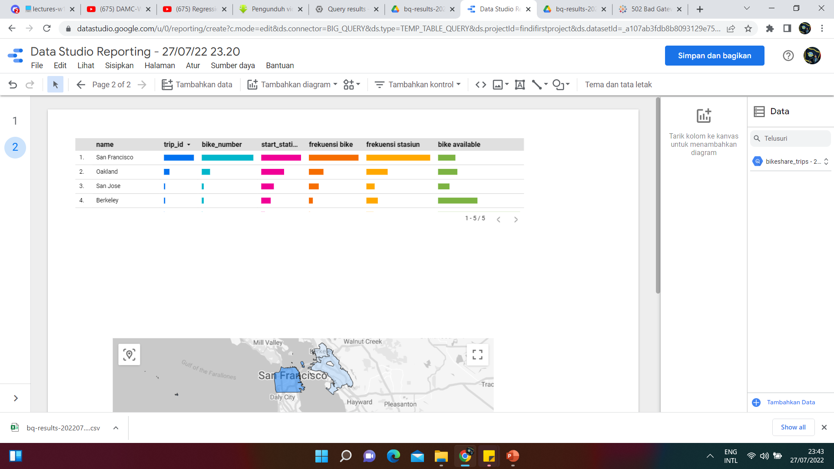
THE DISTRIBUTION’S MAP
From this map we know that many station and bike at San Francisco, but at this place the bike availability is not high

Slide 10






THANK YOU
085231569661
findi.verdian@gmail.com

